Slide 1
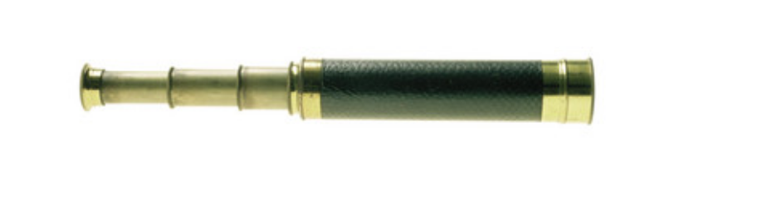
Project Scope Management (PMBOK 6th ed., 2017, pp.129-171)

Slide 2

About
Presented as is, use at your own risk. No warranty with respect to fitness of use.
This is an abridged version of the PMBOK, focusing specifically on what you need to be successful in running a project.
If you sit for the PMP or CAPM, you will need to get the PMBOK 6th addition and develop a more intimate understanding of the material.

Slide 3

Project Scope Management Defined (p. 129)
“…includes the processes required to ensure that the project includes all the work required, and only the work required, to complete the project successfully. Managing the project scope is primarily concerned with defining and controlling what is and what is not included in the project.”

Slide 4

Definition: Predictive Project Management (bv)
High level of attention given to controlling if and how the original design is changed (or not)
Very similar, if not synonyms with “waterfall.”
”Predictive” is PMI’s new word for waterfall
This is the opposite of iterative development (e.g. Scrum)

Slide 5

Scope defined (p. 722)
“The sum of the products, services, and results to be provided as a project”

Slide 6

Project Scope Defined (p. 717)
“The work performed to deliver a product, service, or result with the specified features and functions”

Slide 7
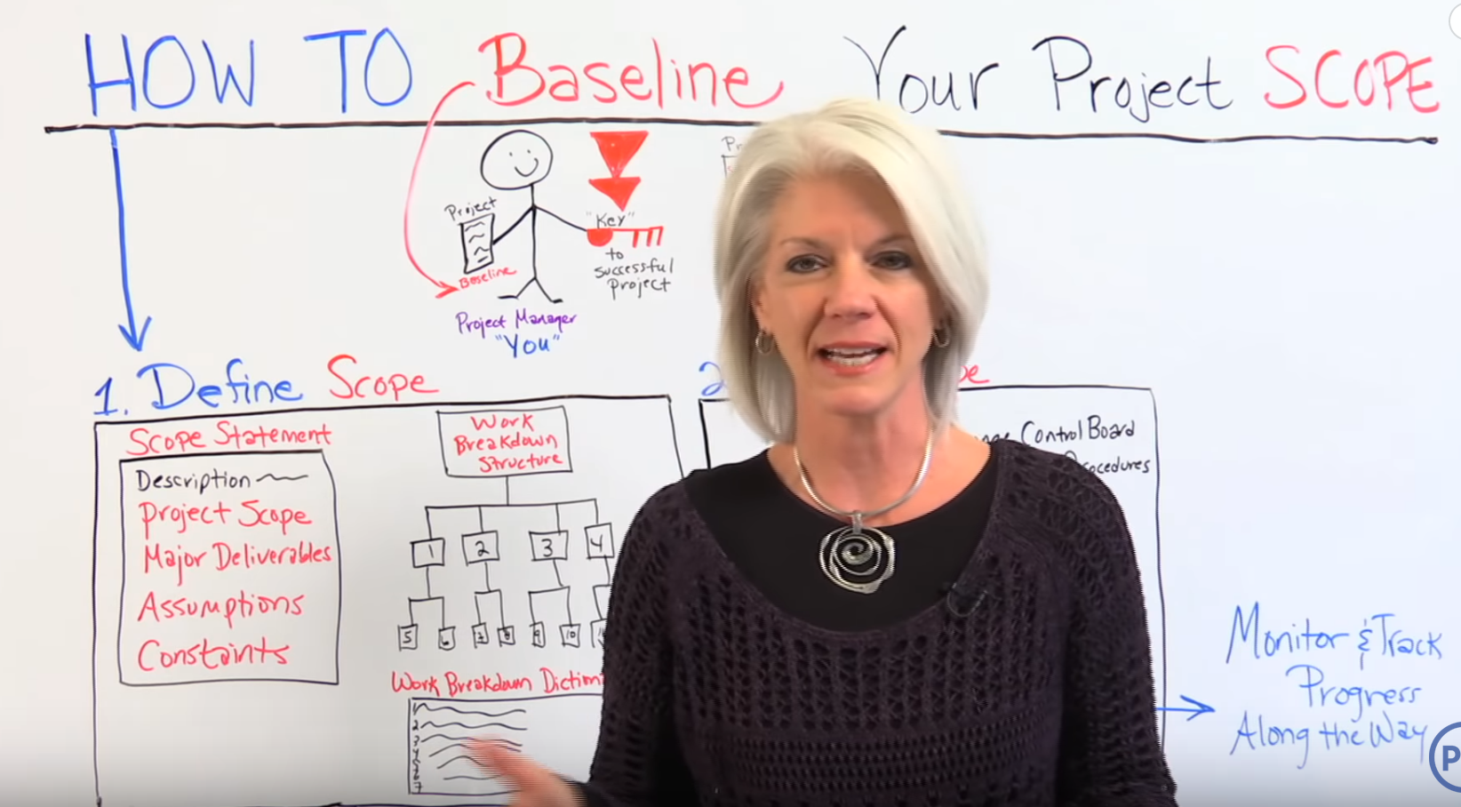
What does it mean to “Baseline?”
https://www.youtube.com/watch?v=64bHiW6K77c

Slide 8
What is change control?
https://www.youtube.com/watch?v=pUfKo14otr4

Slide 9
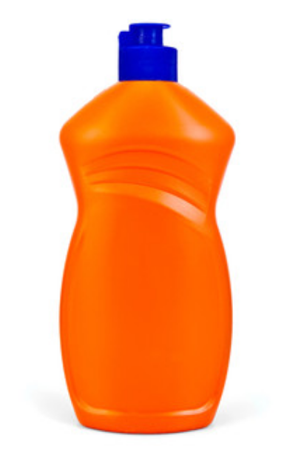
Product Scope (p. 715)
“The features and functions that characterize a product, service, or result.”

Slide 10
Baseline(d) (deliverable) P 699
“The approved version of a work product that can be changed only through formal change control procedures and is used as a basis for comparison to actual results.”

Slide 11
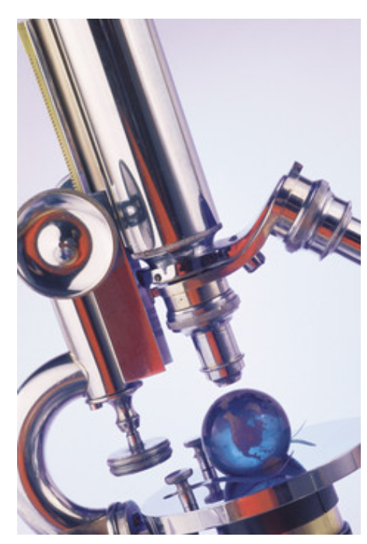
Brian’s definition of scope (bv)
A correct scope statement will identify what the project team is chartered to work on, and what it will not work on.
Scope, in a predictive/waterfall environment can only be changed via a formal change process, where all voting stakeholders must agree to a requested change.
Scope, in a Scrum environment, has less meaning:
It is basically what user stories the Product Owner has created for the team, and the team is willing, with the support of leadership, to work on.
Expect that low value User Stories and Bug Fixes will likely fall out of Scope due to other high priority work drawing resources away from them. When this happens, the Product Owner needs to be kept aware.

Slide 12

PMBOK Requirements Definitions…
Requirement: A condition or capability that is necessary to be present in a product, service, or result to satisfy a business need (p. 719)
Requirements documentation: a description of how individual requirements meet the business need for a project (p. 719)
Collect Requirements is defined as “the process of determining, documenting, and managing stakeholder needs and requirements to meet project objectives.” (p. 701)

Slide 13
Requirements document defined (bv)
A written explanation of the condition or capability that is requested of the performing organization. The request can be for a product, service, or result that addresses a business need.
Based on the SOW, project charter, and/or the business case.
These tend to be formally approved by a unanimous vote of carefully selected stakeholders.
When changed, a change control process must be used.
All items are to have an entry on a requirements traceability matrix (RTM)
These are written by business analysists (“BA”s). BAs use “requirements elicitation” to gather up the details necessary to better understand, and explain (on the requirements document) the business need.

Slide 14

Scope: Predictive vs. Scrum (p. 131) (slide 1 of 3)
“In a predictive life cycle, project deliverables are (specifically) identified at the beginning of the project, and any changes to the scope are progressively managed.”
VS

Slide 15
Scope: Predictive vs. Agile - Scrum (p. 131) (slide 2 of 3)
In an agile (scrum) environment:
At the start of each iteration, the product owner will identify what work they want to be done, in User Story (US) format. These are placed onto something called the “Product Backlog”
The Product Owner will prioritize the user stories in the Product Backlog (bugs are also on the backlog).
The scrum team will work with the Product Owner to “refine” the USs
Scrum team commits to User Stories for the current iteration.

Slide 16
Scope: Predictive vs. Agile - Scrum (p. 131) (slide 3 of 3)
In an agile (scrum) environment continued:
As the iteration matures, ”the sponsor and customer representatives should be continuously engaged with the project to provide feedback on deliverables as they are created and to ensure that the product backlog reflects their current needs.” The main idea here is that change is expected and welcome in a Scrum environment. This supports improved positive, fast, impact in the marketplace.

Slide 17
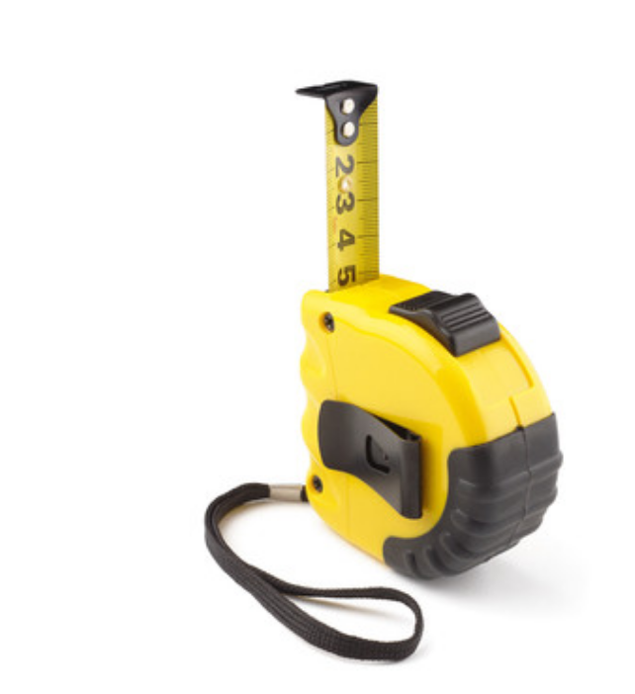
Completion of Project Scope is Measured Against the Requirements (p. 131)

Slide 18

Validate Scope: One key output
Authorized stakeholders need to “sign off”
Also known as “baselining” (BV)
”Sign off” means to formally accept the work product as complete and accurate (bv)

Slide 19
Trends (p. 132)
“The relationship between a project manager and a business analyst should be a collaborative partnership. A project will have a higher likelihood of being successful if project managers and business analysts fully understand each other’s roles and responsibilities to successfully achieve project objectives.”

Slide 20
Another word on Agile (p. 133) – (see next slide)
“… agile methods purposefully build and review prototypes and release versions in order to refine requirements.”

Slide 21
Another word on Agile (bv)
One interesting difference between waterfall and agile is that in waterfall, the tendency is to put nothing into production until the entire project is complete.
In agile, delivery into production can happen anytime the Product Owner and Team agree that it makes sense to deploy code into production.
In a “DevOps” environment, once the work product is accepted by the product owner, it is deployed into production quickly (maybe even instantly). This is called “continuous delivery.” ”Continuous delivery” is one of the key components of DevOps.

Slide 22

Collect Requirements 5.2

Slide 23
Collect Requirements Defined (p. 138)
“… the process determining, documenting, managing stakeholder needs and requirements to meet (project) objectives…(it provides) the basis for defining product scope and project scope.”

Slide 24
Requirements (p. 140)
“... include conditions or capabilities that are required to be present in a product, service, or result to satisfy an agreement or other formally imposed specification.”
”…they include the quantified and documented needs & expectations of the sponsor, customer, and other stakeholders.”
“Requirements become the foundation of the WBS”
“Cost, schedule, quality planning, and procurement are all based on those requirements.”

Slide 25

Some Inputs to Requirements (p. 141)
Project charter
Assumptions log
Expert judgement
Brain storming
Interviewing stakeholders
Focus groups
Surveys
Benchmarking to best practices*
*See next slide

Slide 26

Best Practices Defined From iSixSigma
“A way or method of accomplishing a business function or process that is considered to be superior to all other known methods.”
“A lesson learned from one area of a business that can be passed on to another area of the business”
https://www.isixsigma.com/dictionary/best-practice/

Slide 27

More Inputs to Requirements (p. 143)
Business plans
Current process flows
Request for Proposal (RFP) results
Use cases (who's going to be using it & y)

Slide 28

Requirement Approval Types (p. 144)
Voting
Unanimity (100% agree)
Majority (greater that 50%)
Plurality (largest group decides)
Autocratic (one person decides)
Multicriteria decision making analysis (decision matrix- specific requirements vs. ability to meet those required items)

Slide 29

Nominal Group Technique (pp. 144 – 145)
Used to rank brainstorming output
A question is proposed
Each team member creates ideas
All ideas boarded (without names)
All team members understand all ideas
Each person ranks each idea 1-5
Highest ideas are selected for moving forward with

Slide 30

Prototypes (p. 147)
Provide a limited model of the perceived end state deliverable so the client can see what they are about to pay for.
Supports client learning, expectation setting, and effective communication between client and development team (bv)
Progressive elaboration can be supported by this.
Wireframes fit in here (bv)

Slide 31
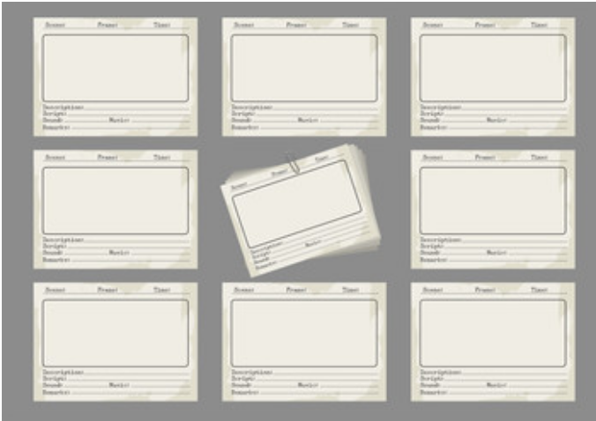
Prototypes: Story Boards in IT (p. 147)
Shows navigation paths between:
Screens
Web pages
Interfaces between applications

Slide 32

Before Baselining Requirements Need To Be…(p. 147)
Unambiguous (measurable and testable)
Traceable
Complete
Consistent
Need to have key stakeholder acceptance

Slide 33
Different Requirements Types (p. 148)
Business requirements (organizational needs)
Stakeholder requirements (needs of a particular group of stakeholders)
Solution Requirements (features, functions, characteristics of the product or service)
Functional requirements: Behaviors (actions, processes, data and interactions)
Non-Functional (see next slide):

Slide 34
Non Functional Requirements (p. 148) (continued from previous slide)
They support functional requirements
They describe:
Environmental conditions
Necessary qualities for the product or service to be successful
They are often referred to as the “ilities” in industry (bv)
Reliability
Security
Safety
Supportability
Performance
Level of service
Retention periods*

Slide 35

Requirements Traceability Matrix (A.K.A. RTM) (p.148-149)
Main idea: each line of a requirement links right back to a specific ask in the business case, or another document with the same expectation (bv)

Slide 36

Some RTM uses…(p. 149)
Opportunities, goals
Project objectives
Scope and WBS deliverables
Product design
Product development
Test strategies and test scenarios
High-level requirements to more detailed requirements

Slide 37
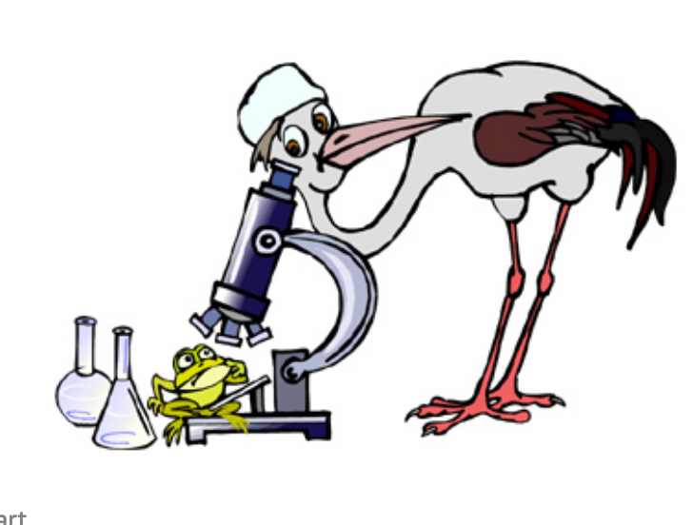
5.3 Define Scope (p150)
Defined: ”the process of developing a detailed description of the project and product.”
Benefit: ”describes the product, service, or result boundaries and acceptance criteria.”

Slide 38
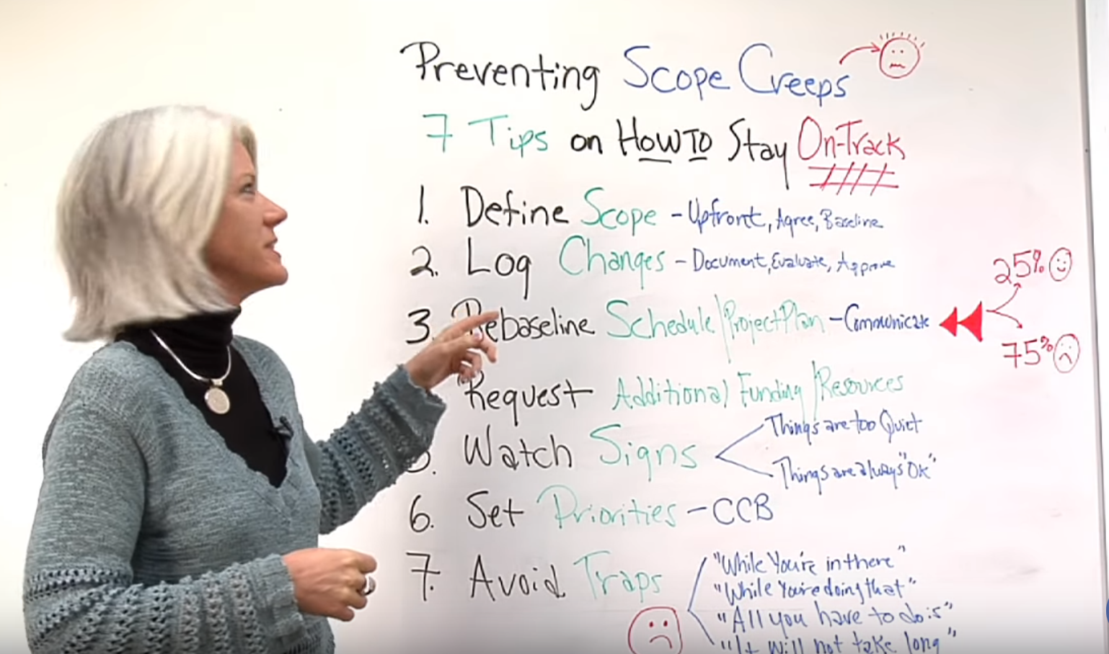
7 Sources of Scope Creep: 7 min
https://www.youtube.com/watch?v=lKcJW1XqY4E

Slide 39

During project planning (p 151)
“project scope is defined and described with greater specificity as more information is known about the project.”

Slide 40

Some inputs: (p 152)
Project charter
Project management plan (how scope will be defined, validated, and controlled.)
Other typical documents as input…
Assumptions log
Requirements documents
Risk register
Lessons learned

Slide 41

How? (p 153)
Expert judgement
Data analysis
Team input
Product analysis (“asking questions about a product or service and forming answers to describe the use, characteristics, and other relevant aspects of the key deliverable.”)

Slide 42

Define Scope Outputs:
Product scope description (often done through progressive elaboration)
Deliverables
Acceptance criteria
Project exclusions (what is not included)

Slide 43
5.4 create WBS Covered under separate presentation

Slide 44

5.5 Validate Scope (p 163)
Defined: “Formalizing acceptance of the completed project deliverables”
Value: “It brings objectivity to the acceptance process and increases the probability of final product, service, or result acceptance by validating each deliverable.”

Slide 45

Verification: (P 164)
“The verified deliverables obtained from the Control Quality process are reviewed with the customer or sponsor to ensure they are completed satisfactorily and receive formal acceptance of the deliverables by the customer or sponsor.”

Slide 46

Validate Scope: T&T (p 166)
Inspection
Measure
Examine
Validate
“determine whether work and deliverables meet requirements and product acceptance criteria.”

Slide 47

Acceptance (p 166)
“Deliverables that meet the acceptance criteria are formally signed off and approved by the customer or sponsor.”

Slide 48
5.6 Control Scope (p 167)
Defined: ”the process of monitoring the status of the project and product scope and managing changes to scope baseline.”
Value: “The scope baseline is throughout the project.” … “Controlling the project scope ensures all requested changes and recommended corrective or preventative actions are processed through the ’perform Integrated Change Control’ process.”
Comment:” Change is inevitable” you need a change control process!

Slide 49

Example of Out of Control Scope Change

Slide 50
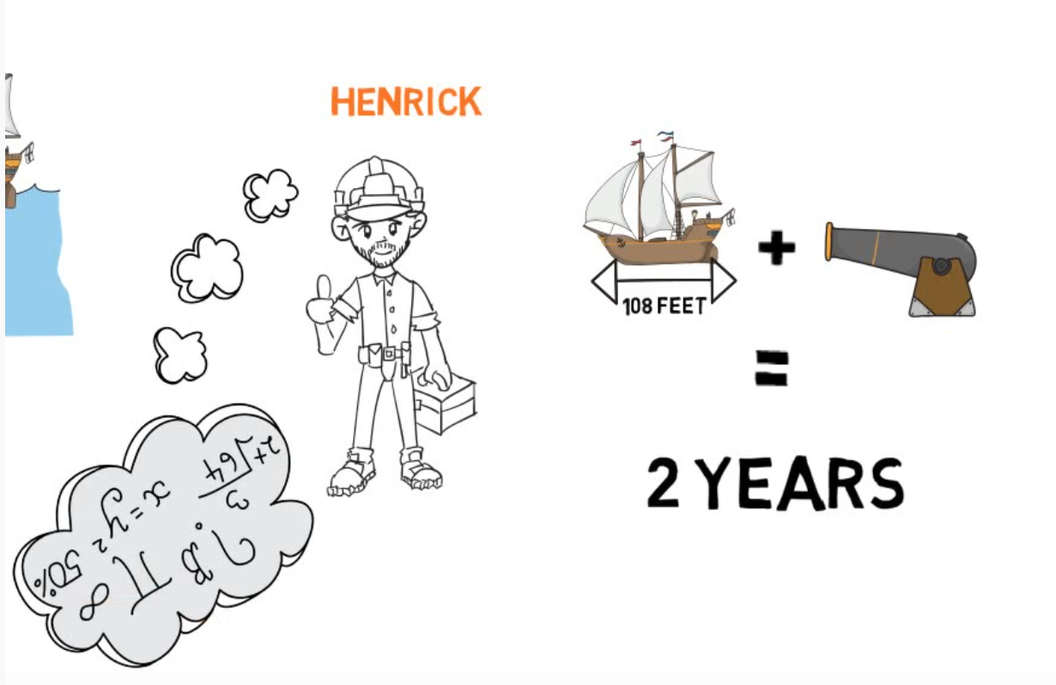
The Vasa/Wasa War Ship (8 min)
https://www.youtube.com/watch?v=kmJ59yyYza4

